Slide 1
Case study:
THE EUROPEAN PORTFOLIO FOR STUDENT TEACHERS OF LANGUAGES (EPOSTL)
IN BULGARIA
Sylvia Velikova
Bulgarian English Teachers’ Association (BETA)
University of Veliko Turnovo, Bulgaria

Slide 2
Key steps to implementing the EPOSTL
Getting started: information about the ECML project and the EPOSTL
Understanding the national and local context and the need for change
Piloting phase and developing the implementation rationale
Following the implementation stages and procedures
Conducting continuous evaluation and improvement

Slide 3
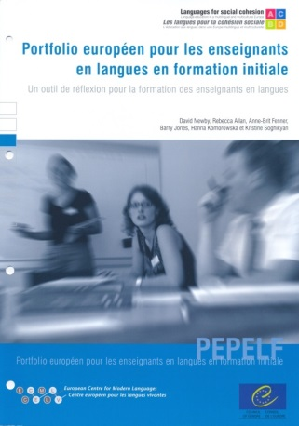

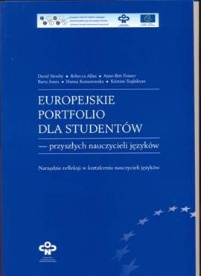
European Portfolio for Student Teachers of Languages: A reflection tool for language teacher education
ECML projects:
From Profile to Portfolio: A Framework for Reflection in Language Teacher Education (2004-2007)
Piloting and Implementing the European Portfolio for Student Teachers of Languages (2008-2011)

Slide 4
Context
The institutional context: the English language teacher education programme at the Faculty of Modern Languages, University of Veliko Turnovo, Bulgaria
The need for change: the need to introduce a systematic focus on reflection in teacher education in Bulgaria
“student teachers find it problematic to reflect on their experience during teaching practice and to self-evaluate their teaching”
Baseline Survey of Pre-service English Language Teacher Education in Bulgaria 2001-2002 (Thomas et al., 2002)

Slide 5

Aims:
To encourage student teachers to reflect on the competences a teacher strives to attain and on the underlying knowledge which feeds these competences;
To help prepare prospective teachers for their future profession in a variety of teaching contexts;
To promote discussion between student teachers and their peers, and between student teachers and their teacher educators and mentors;
To facilitate self-assessment of prospective teachers’ developing competence;
To provide an instrument which helps chart progress. (EPOSTL 2007)

Slide 6
Purpose
To create, scaffold and sustain a culture of reflection in ELTE at the University of Veliko Turnovo
This involves cultivating beginning teachers’ capacity to undertake thoughtful inquiry in and on action, both individually and in collaboration with others, and to re-examine and become critically aware of their own assumptions (based on knowledge, experiences, beliefs, values) about learning and teaching within a broad context of issues: cultural, social, political, etc. (Dewey 1910, Schön 1983, Frierie 1970, Habermas 1971, Mezirow, 1990).

Slide 7
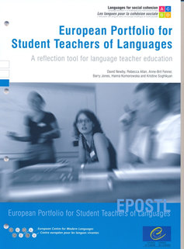
Main sections:
Personal Statement to encourage student teachers to reflect on general questions related to teaching and learning to teach;
Self-Assessment section which maps out didactic competences in the form of ‘can-do’ descriptors;
Dossier which assists student teachers in documenting progress and examples of work relevant to their teacher education and their future profession

Slide 8
Piloting
WHEN?
When should we introduce the EPOSTL: at the beginning of their teacher education when they follow theoretical, university-based courses or later, during their school-based teaching practice?
WHAT?
What activities can be infused into the programme in order to help student teachers take ownership of the portfolio development process and make better use of the document as a reflection and self-assessment tool in the long term?

Slide 10
Piloting
HOW?
Should the introduction of the EPOSTL follow a step-by-step procedure through which student teachers are gradually familiarized with the portfolio content and rationale?

Slide 11
Implementation framework
There are three stages to the EPOSTL implementation
1). The ELT methodology course;
2). Teaching practice I and II;
3). Teaching Practice III.
These stages take place over the period of 2 academic years (4 semesters).

Slide 12
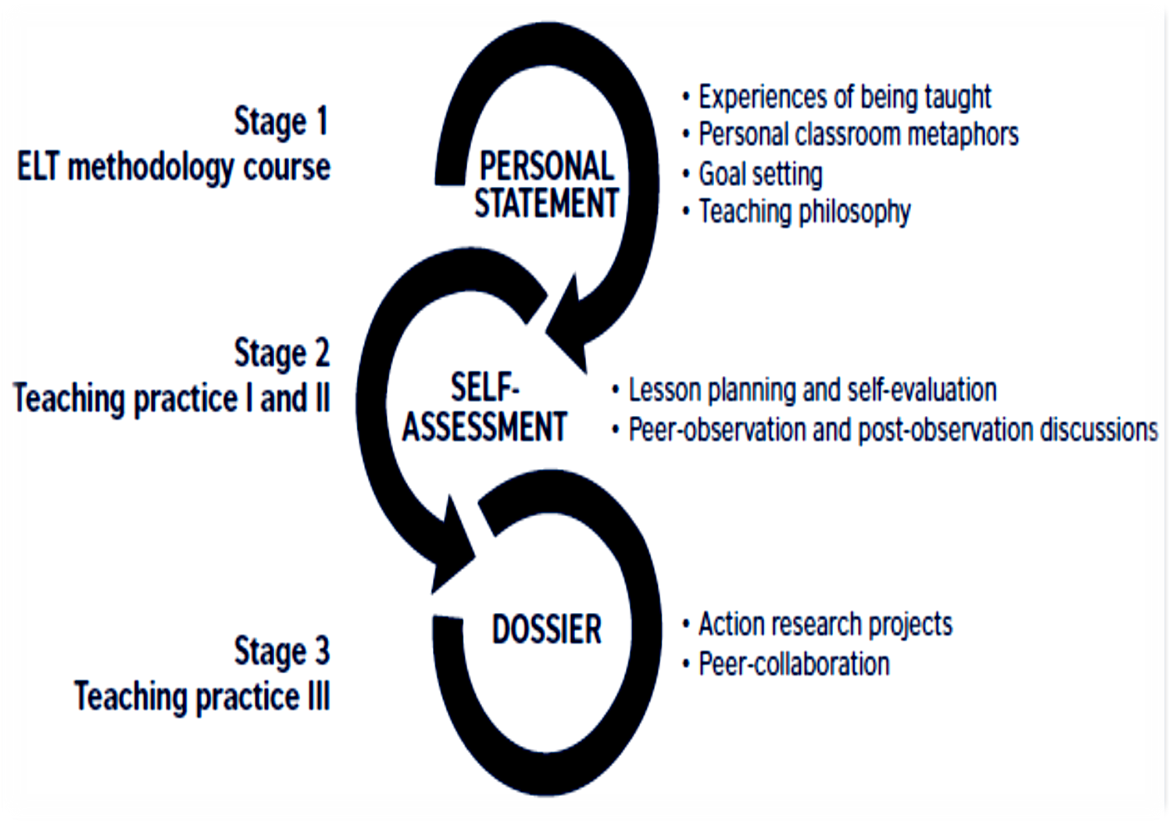

Slide 13
Evaluation
Student teachers’ voices
“When I began reading the EPOSTL I determined to discover in what way it was designed to help me in my teacher education. Was it a manual I had to learn and apply? Were there a number of steps which I had to accomplish so as to be successful as a teacher. Very much to my pleasure, I found it was neither of these; at least that is how it seemed to me. Rather, it looks like its purpose is to help me do self-analysis and in this way discover my weaknesses and strengths, and in this way improve.” (Kremena, 2008)

Slide 14
Evaluation
Student teachers’ voices
“Firstly I would like to say that I am an Erasmus student from Spain and that this has been a great experience, here in Bulgaria and especially in this subject. I have been working with a different methodology where everybody participates and where we are constantly sharing our opinions, ideas and knowledge. I really like the fact that the professor does not give us a book with theory and told us to study it, we have been creating our own knowledge in each class and with the different presentations of my classmates. Finally I can say that after attending this class I have reconsidered the way I teach.” (Luis, 2015)
“Not only we have learned activities; we have also learned to work with the European Portfolio for Student Teachers of Languages.” (Alba, 2015)

Slide 15
Evaluation
Mentors’ voices
“Students who use the EPOSTL are more responsible of their own development. They show better skills in planning their activities; they are more motivated in general and reflect on their practice. Collecting materials for the portfolio and analysing the results, makes it easier for them to self-assess and set clearer goals for future development.” (Gloria)

Slide 16
Conclusions
Promotion/awareness-raising of a project and a project result without an effective implementation strategy cannot ensure sustained impact
An implementation project is most effective when it is carried out within a flexible framework of activities and over time
Implementation is a collaborative process that requires constant monitoring, evaluation, and improvement.

Slide 17
Publications
Newby, D., Fenner A.-B. and Jones, B. (2011) Using the European Portfolio for Student Teachers of Languages. Council of Europe, 2011 http://www.ecml.at/Resources/ECMLPublications/tabid/277/language/en-GB/Default.asp
Publications and Online Materials Related to the EPOSTL, Compiled by Eva-Lisa Hasan http://epostl2.ecml.at/LinkClick.aspx?fileticket=UYBfc6nkb3A%3D&tabid=3548&language=de-DE
Velikova, S. (2013) „Using the European Portfolio for Student Teachers of Languages (EPOSTL) to Scaffold Reflective Teacher Learning in English Language Teacher Education,“ In J. Edge & S. Mann (eds), Innovations in Pre-service Education and Training for English Language Teachers, British Council UK, pp. 201-216 http://www.teachingenglish.org.uk/sites/teacheng/files/C442_Innovations_PRESETT_FINAL_WEB%20ONLY_v2.pdf
Velikova, S. (2009) “Implementing the European Portfolio for Student Teachers of Languages in a Lifelong Learning Context” In Pia-Maria Rabensteiner, & Eero Ropo (eds), The European Dimension in Education and Teaching: Identity and Values. Schneider Verlag Hohengehren, 93-106

